Slide 1

SYSTEM DRIVEN HARDWARE DESIGN Final Presentation Development of a 24 GHz RADAR Sensor for movement detection
Group : A6
Prajwal Mangaluru (1134277)
Dheeraj Swaroop Saligrama Mahesh (1134298)

Slide 2
Agenda
Introduction
Block Diagram
Schematic and PCB design
3D View and Soldered PCB
State Machine
Software Top Design
Testbench
Hardware Testing
RADAR Testing
CFAR Algorithm

Slide 3
Introduction
A 24 GHz radar sensor detects movements and send Doppler frequency to bandpass filter if the movement is detected.
The 4th order Bandpass filter gives Baseband signal as the output which in-turn is send to the ADC.
Algorithms like FFT and CFAR, implemented in FreeSoC, enable precise target detection by identifying variations in the reflected signals.

Slide 4
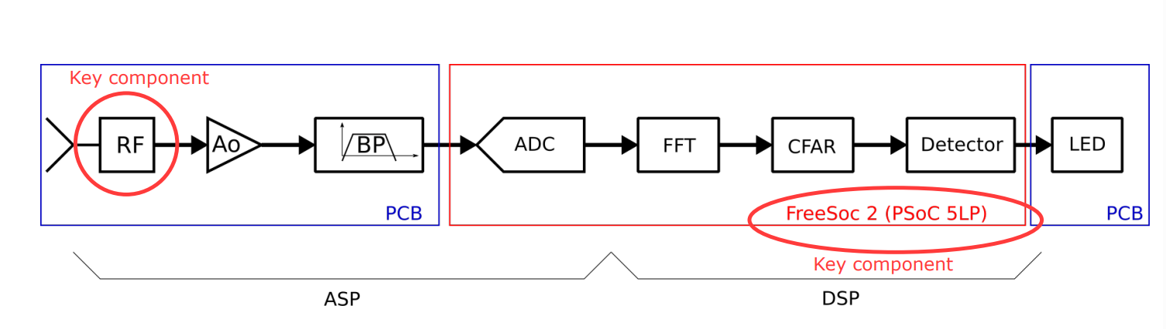
Block Diagram
The radar captures the RF signal.
The signal is amplified and filtered to reduce noise.
An ADC converts the cleaned analog signal into digital form.
FFT analyzes the signal’s frequency components.
CFAR filters out background clutter, highlighting potential targets.
The system confirms if a real object is present.
An LED lights up to indicate a detected target.

Slide 5
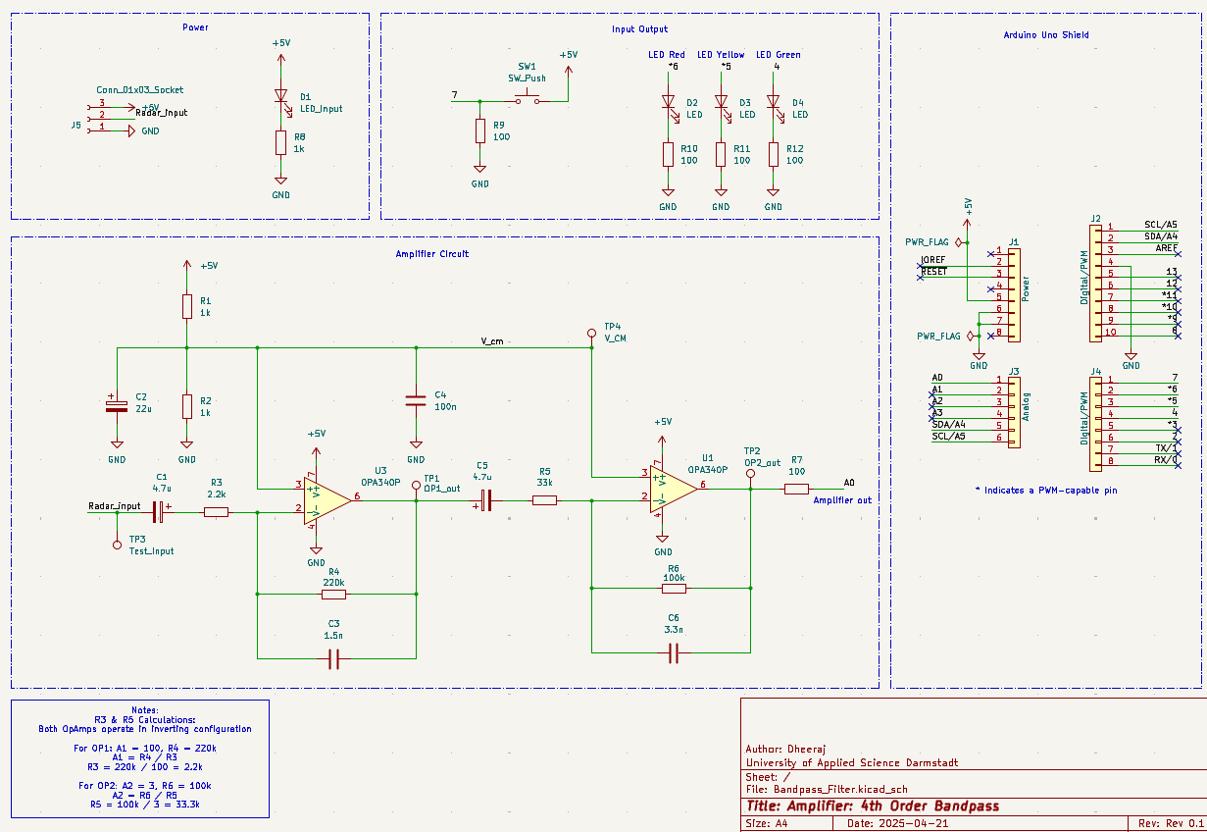
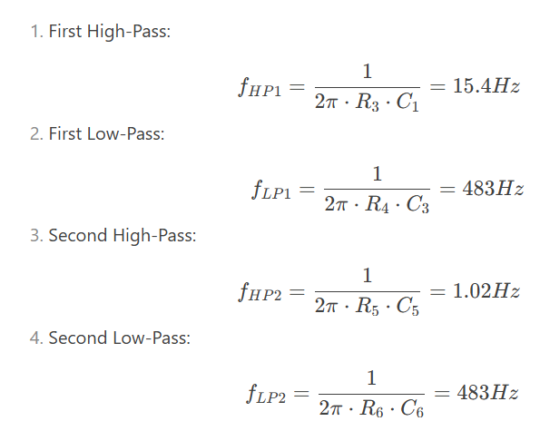
KiCad Schematic
Corner Frequency Calculations:

Slide 6
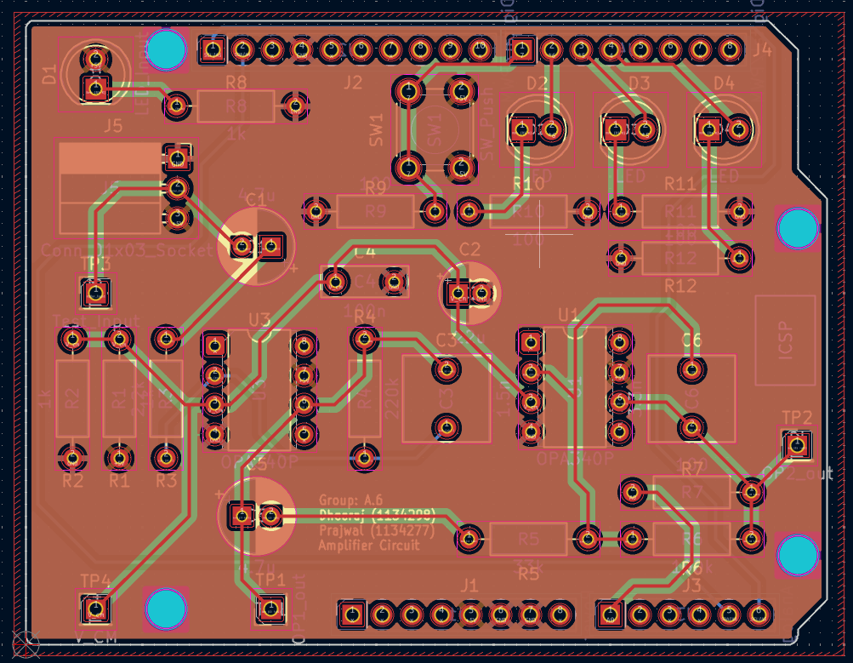
KiCad PCB Layout Design
Built using Through-Hole Technology (THT) for component mounting on the PCB.
Four PCB layers:
i. Front Copper
ii. Ground
iii. VCC
iv. Back Copper
Digital and analog grounds are isolated to avoid interference.
Powered by the FreeSoC board.

Slide 7
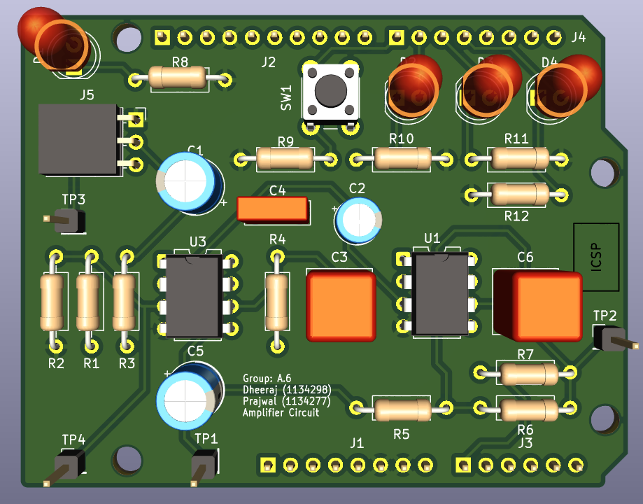
PCB 3D View and Soldered PCB
PCB 3D View
PCB Top View

Slide 8
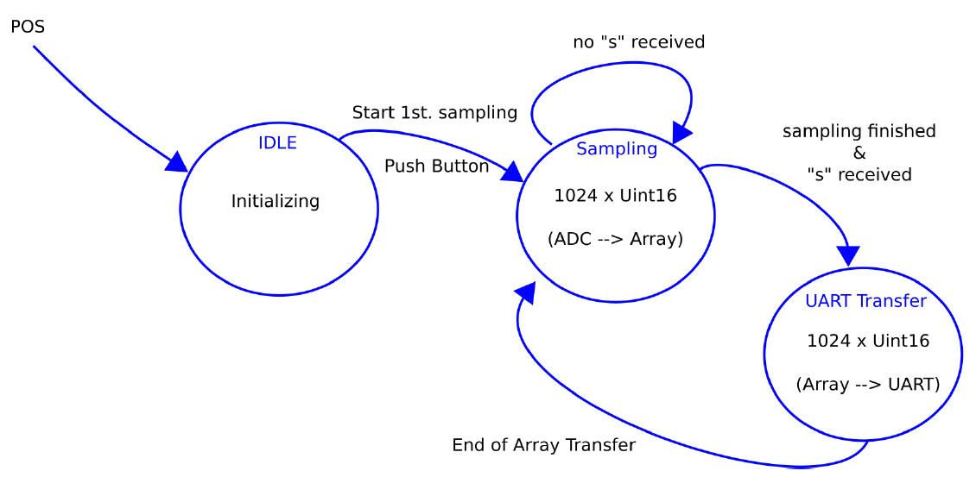
State Machine
This project utilizes the FreeSoC2 to sample analog signals through its ADC and send the digital data to MATLAB for processing.
It was later extended to include FFT for frequency analysis and a CFAR algorithm to adaptively control the false alarm rate.

Slide 9
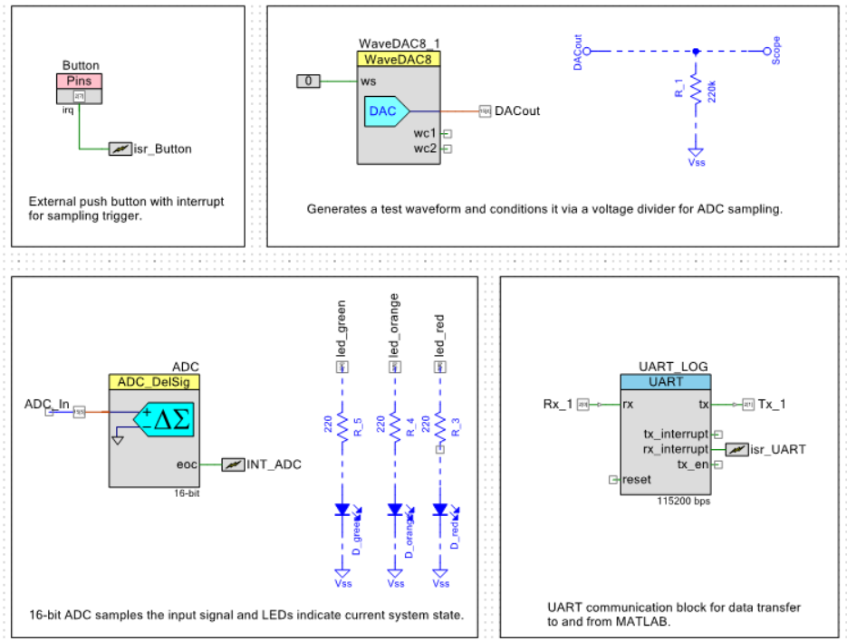
Software Top Design

Slide 10
Testbench
Voltage Divider Calculations:
Vin = 0.2V
Outpput (2nd Stage) = 2.4V
Output (1st Stage) = 2.4V / 3 = 800mV
Output (I/P to 1st Stage) = 800m / 100 = 8mV
8mV = (Vin x R2) / (R1 + R2)
R2 / (R1 + R2) = 0.04
Choose R2 = 100Ω
After solving above Equation:
R1 = 2.2kΩ
DAC Out P15[4]
P2[4]
LEDs to indicate State
Button
100Ω
Voltage Divider Circuit
V/G Div O/P to ADC In P15[5]
2.2kΩ

Slide 11
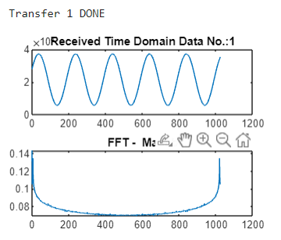
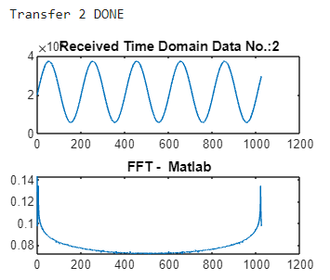
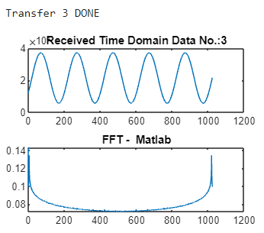
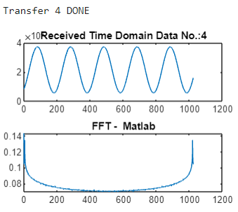
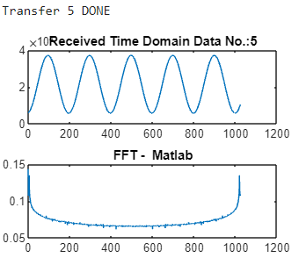
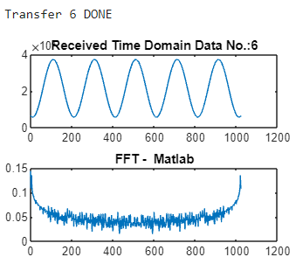
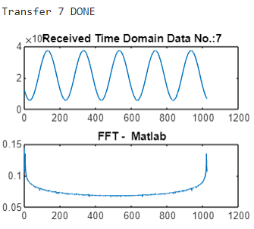
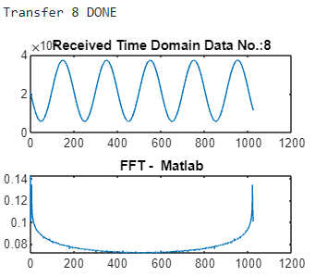
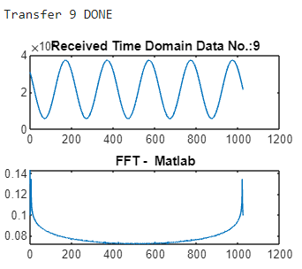
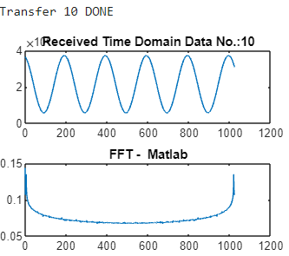
MATLAB Output

Slide 12
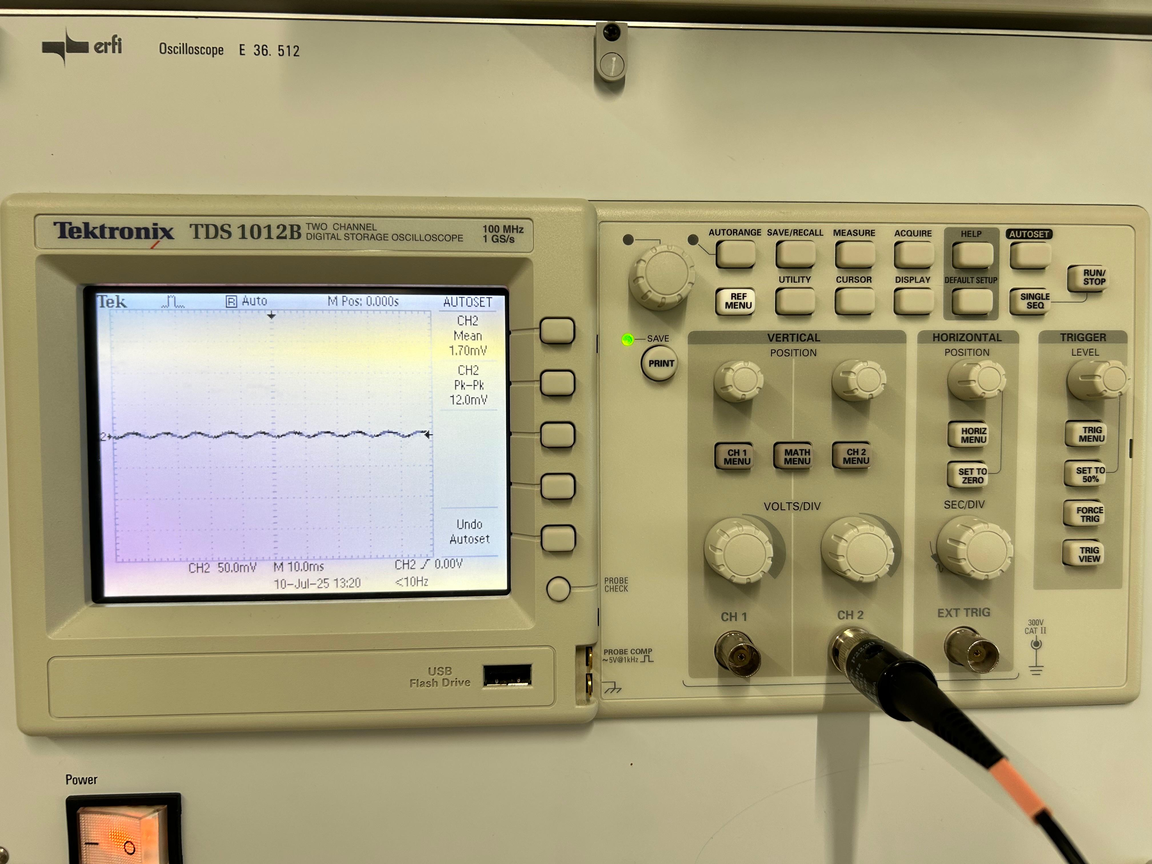
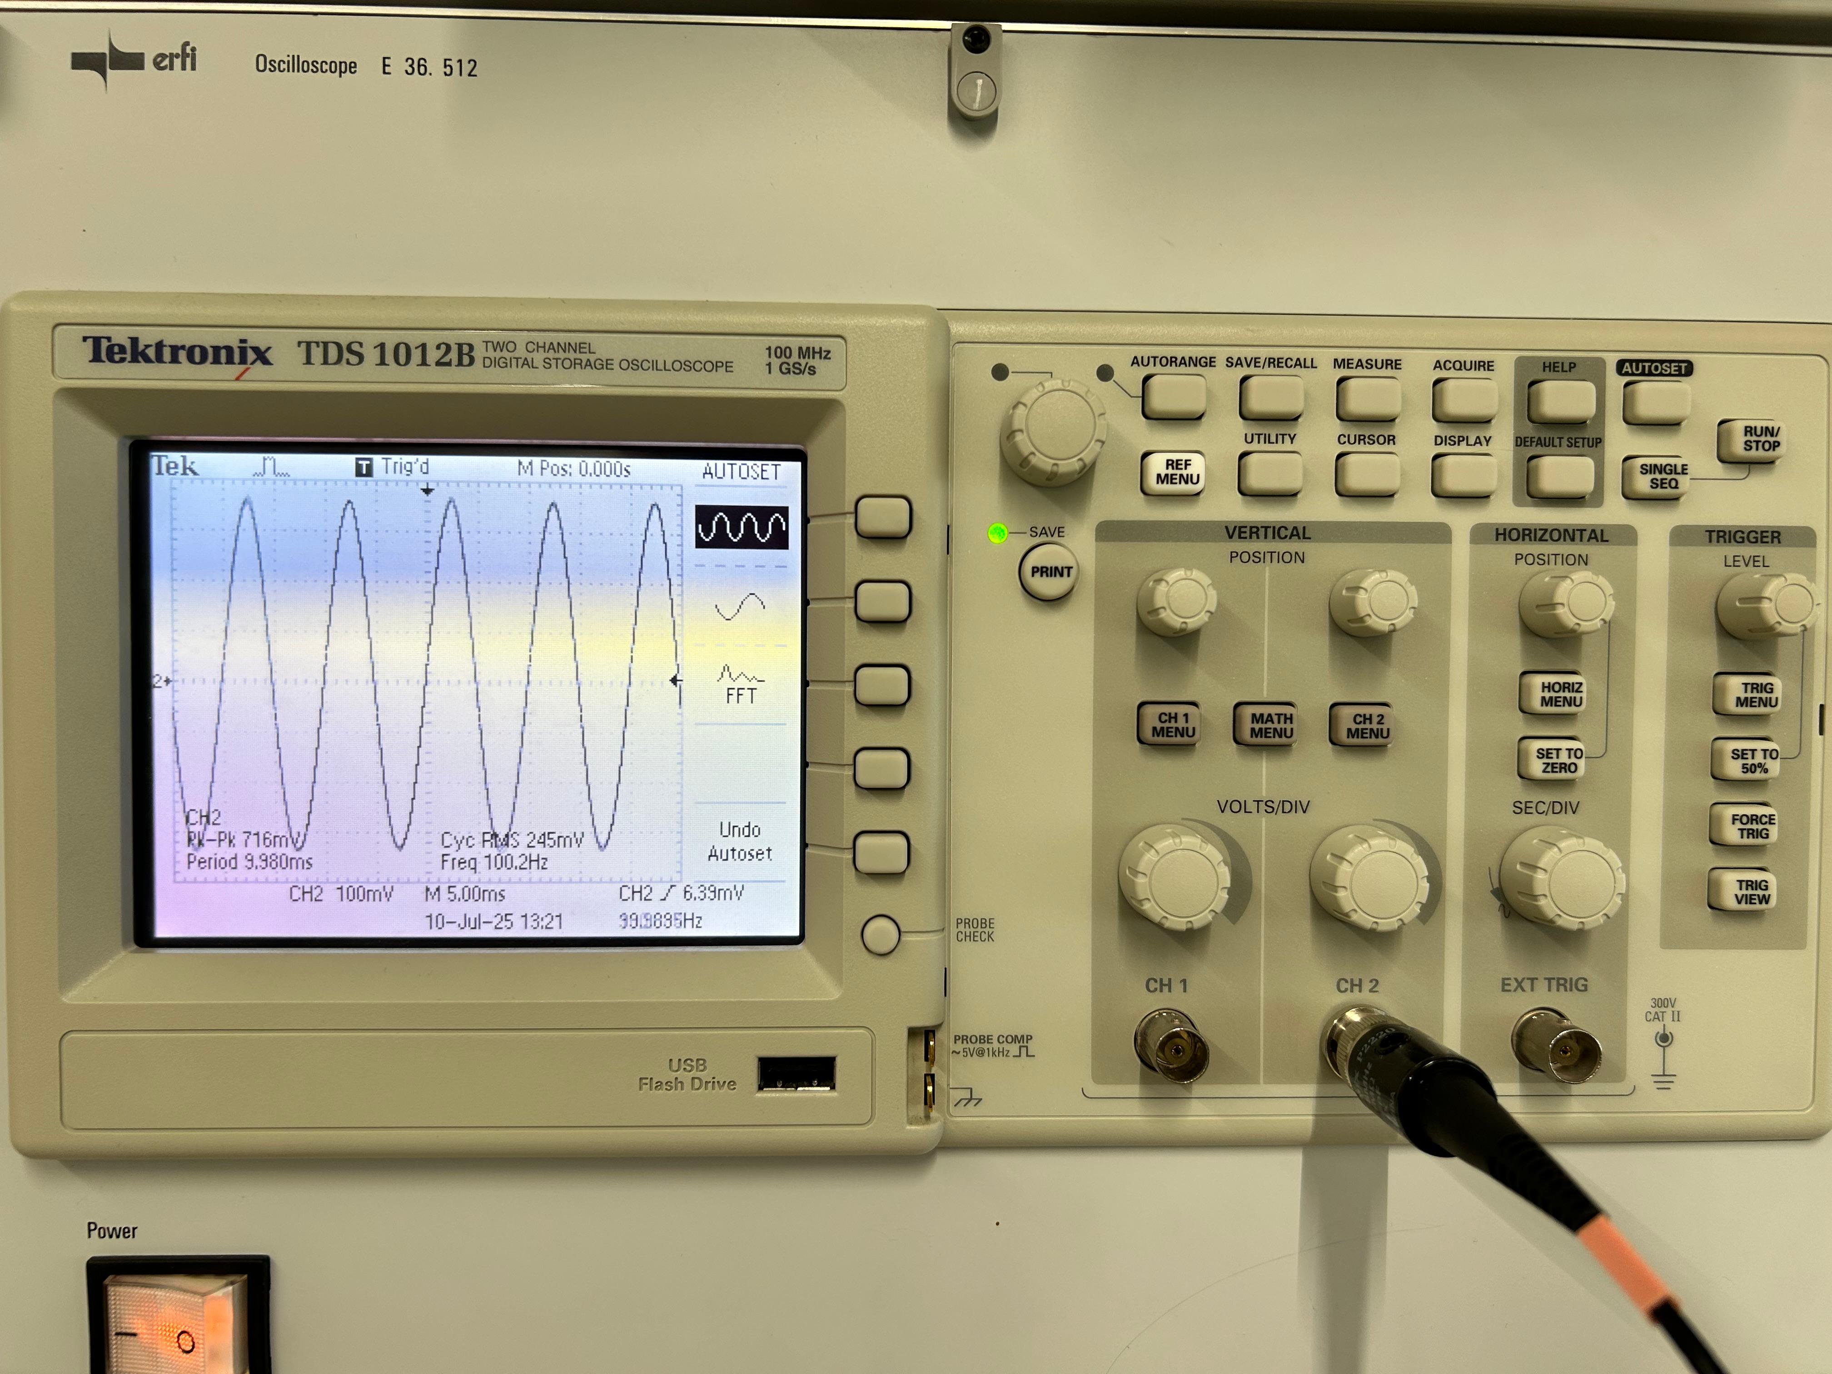
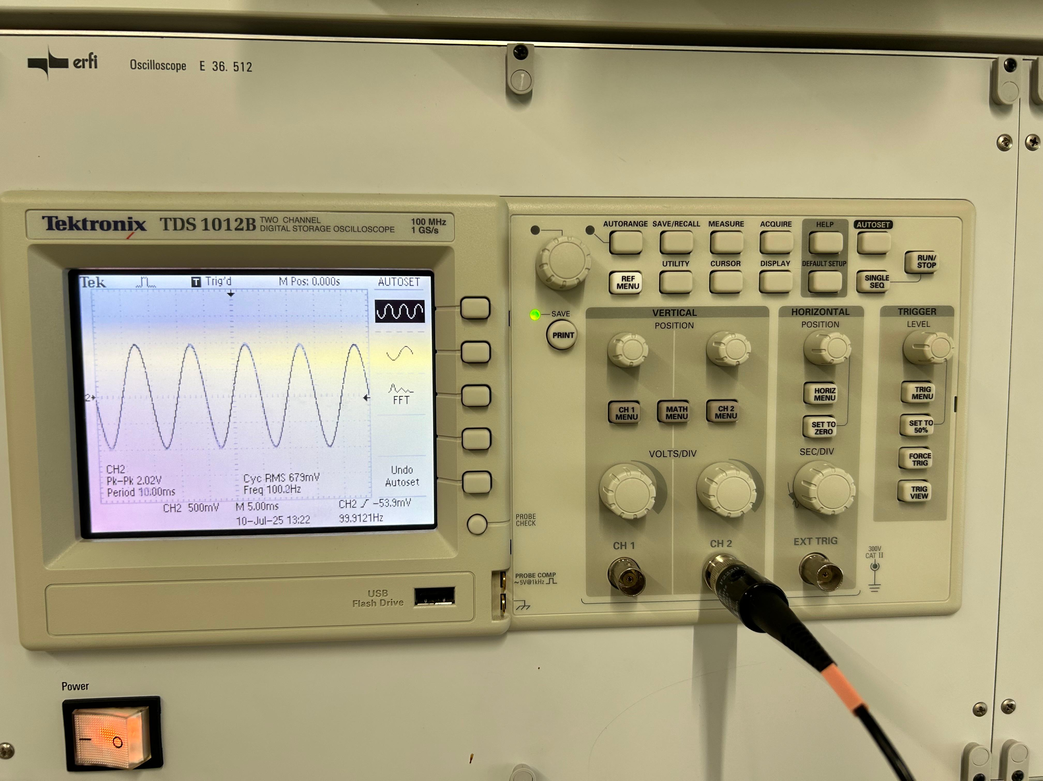
Hardware Testing
Voltage Divider Output
Expected : 8mV
Actual : 12mV
Amplifier 1st Stage Output
Expected : 800mV
Actual : 716mV
Amplifier 2nd Stage Output
Expected : 2.4V
Actual : 2.02V

Slide 13
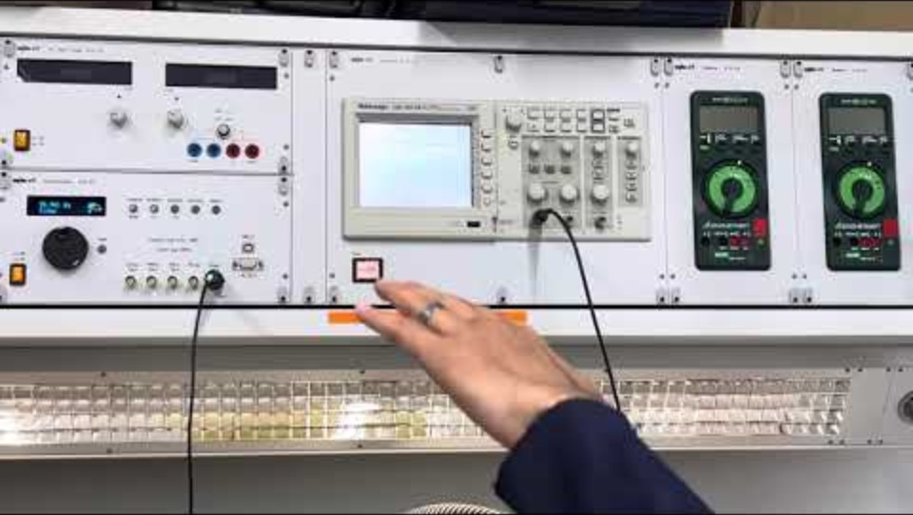
RADAR Testing

Slide 14
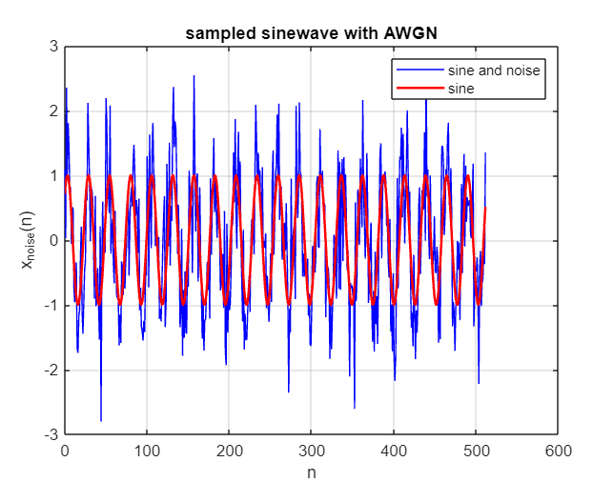
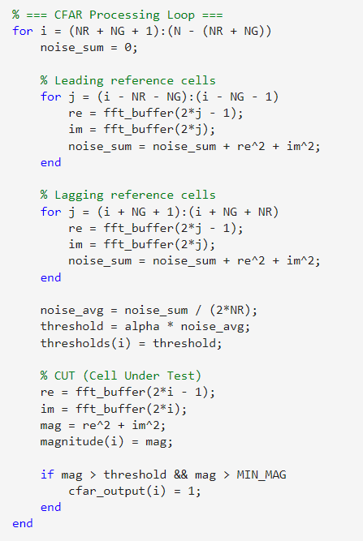
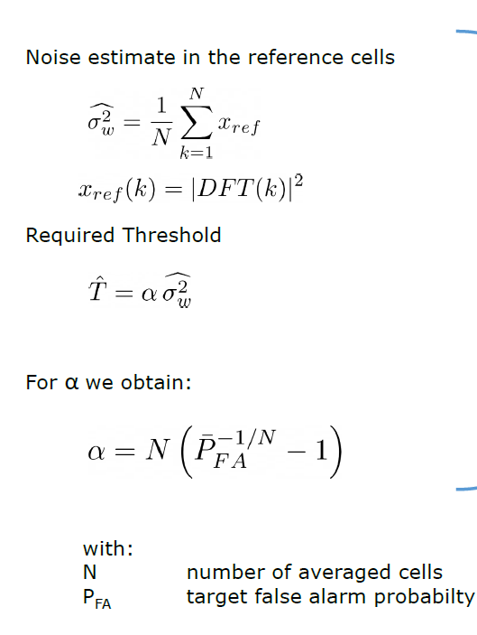
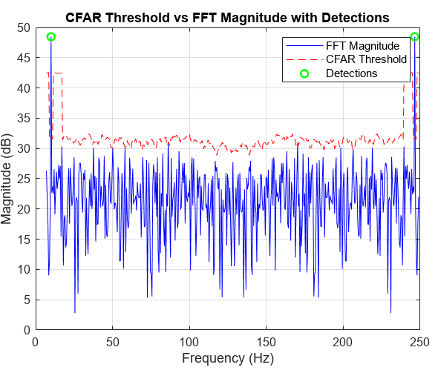
CFAR Algorithm Implementation – MATLAB (Test Input)

Slide 15
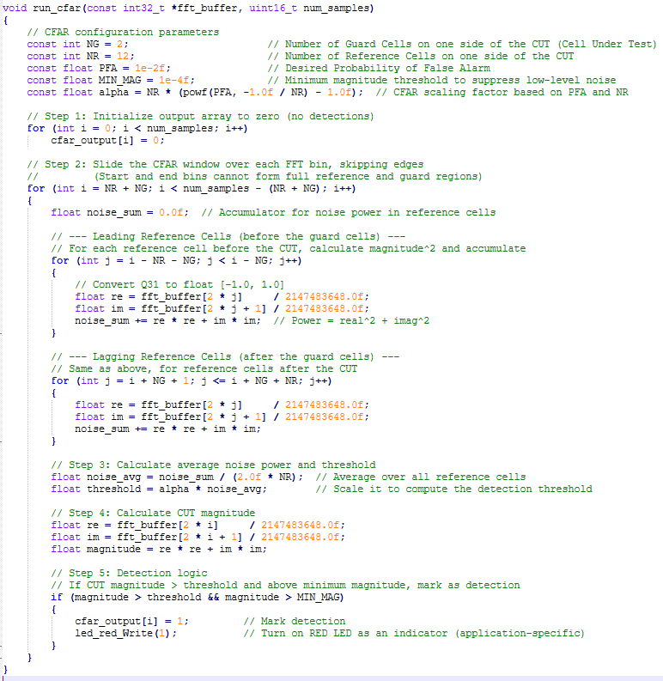
CFAR Algorithm Implementation - PSoC

Slide 16
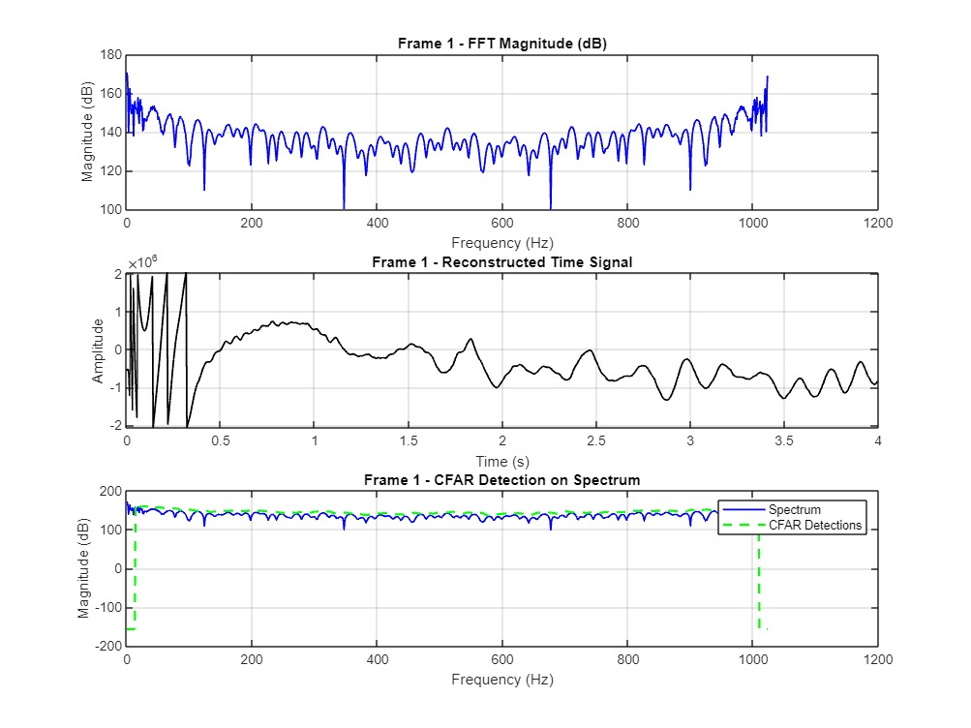
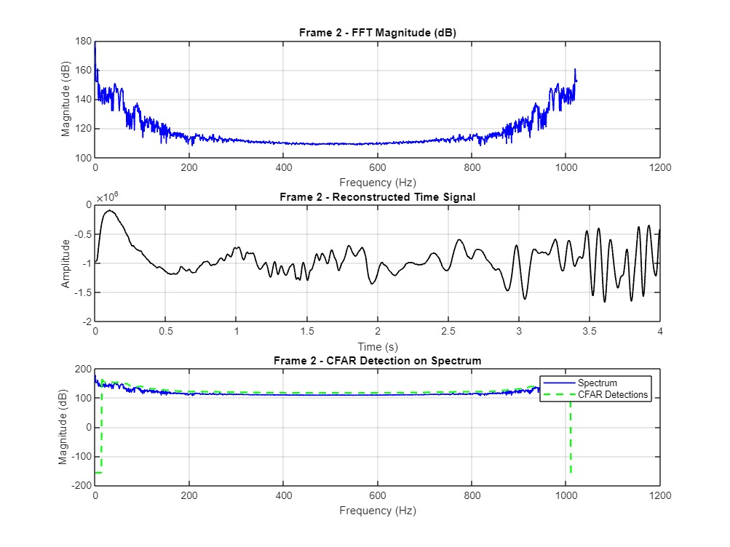
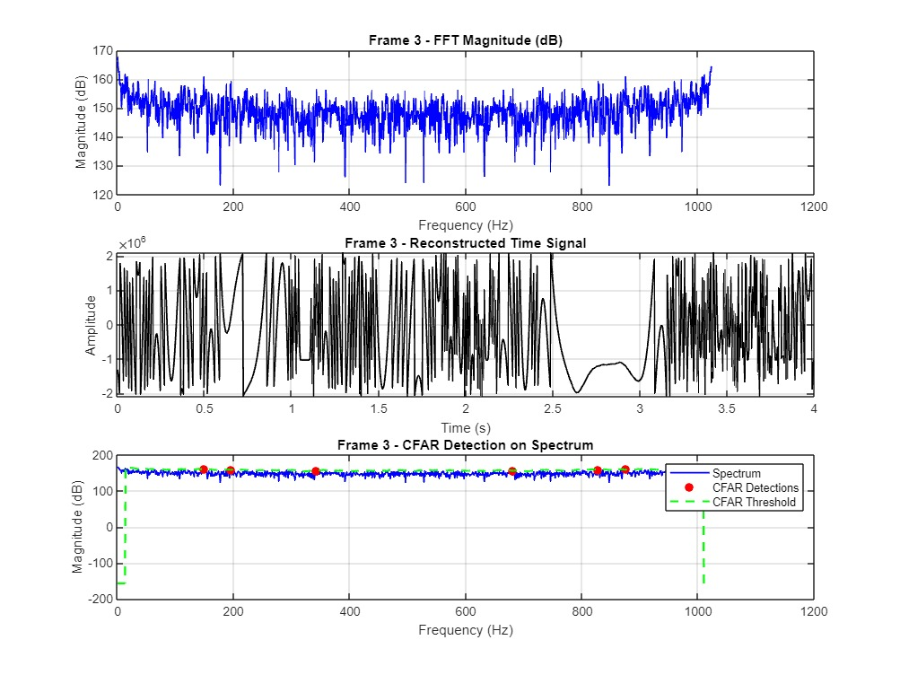
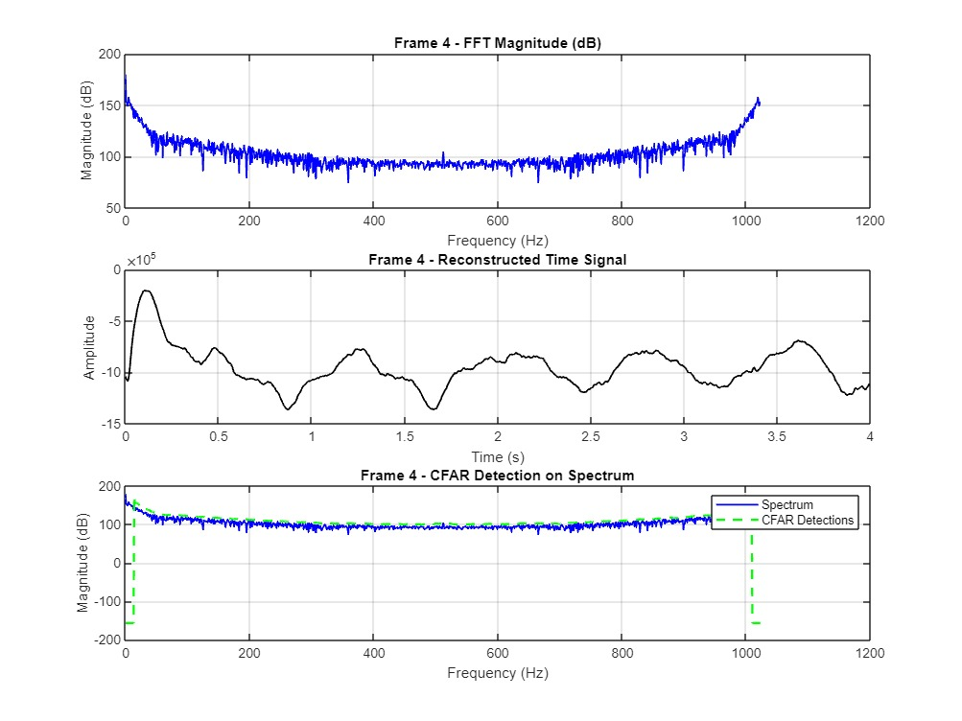
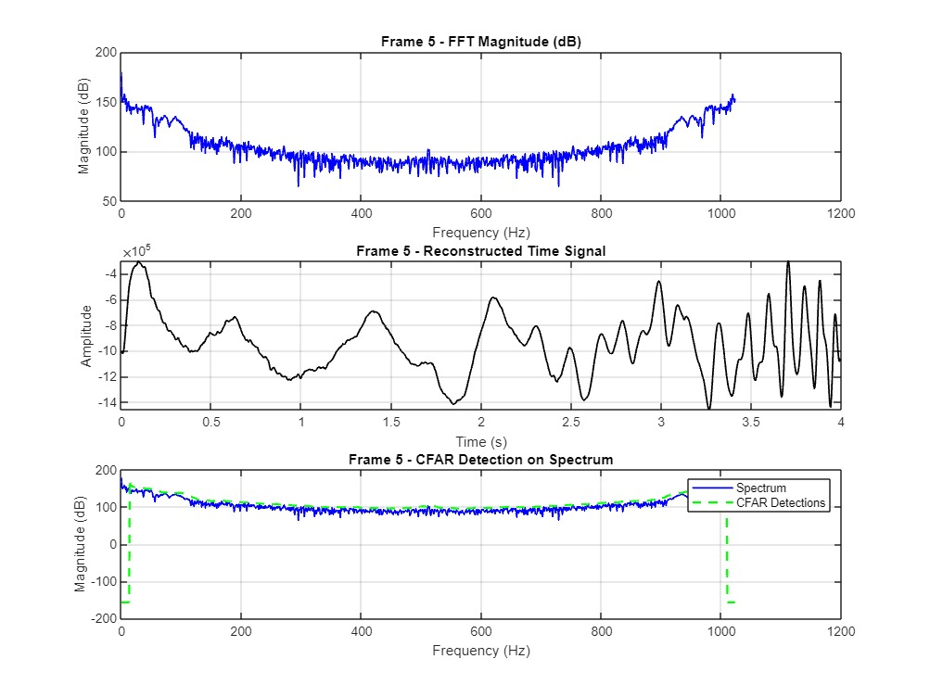
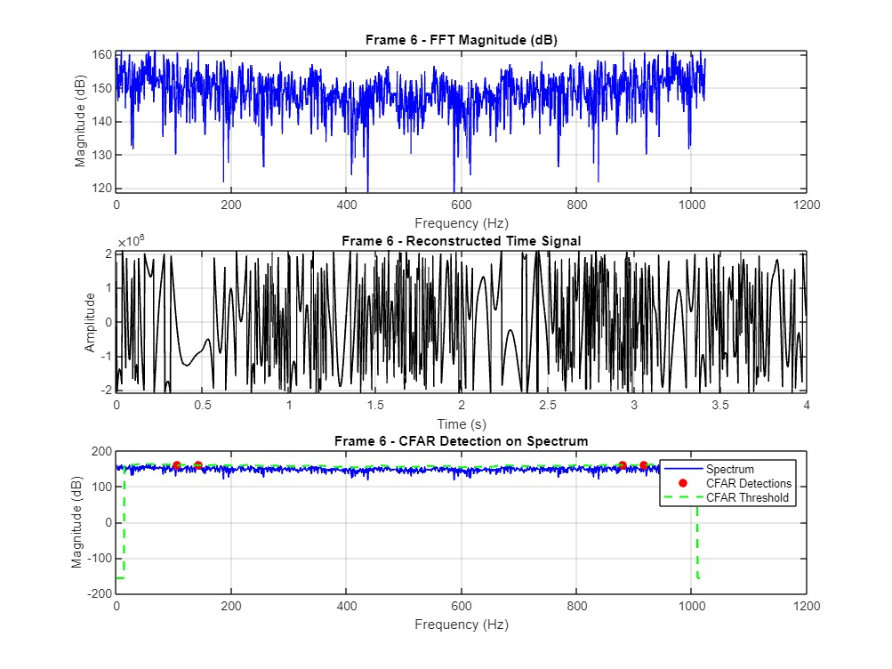
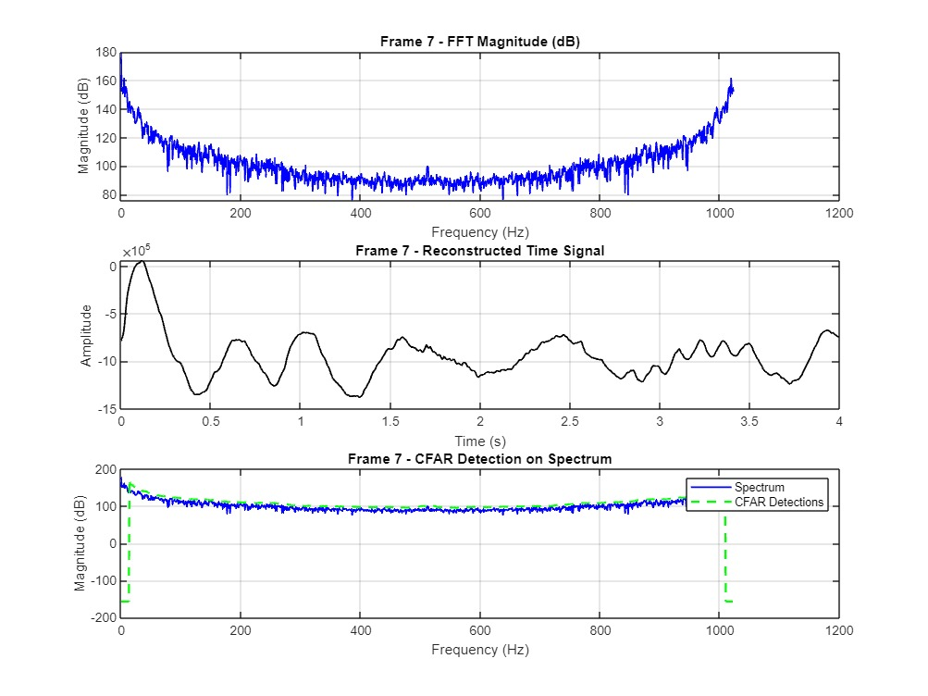
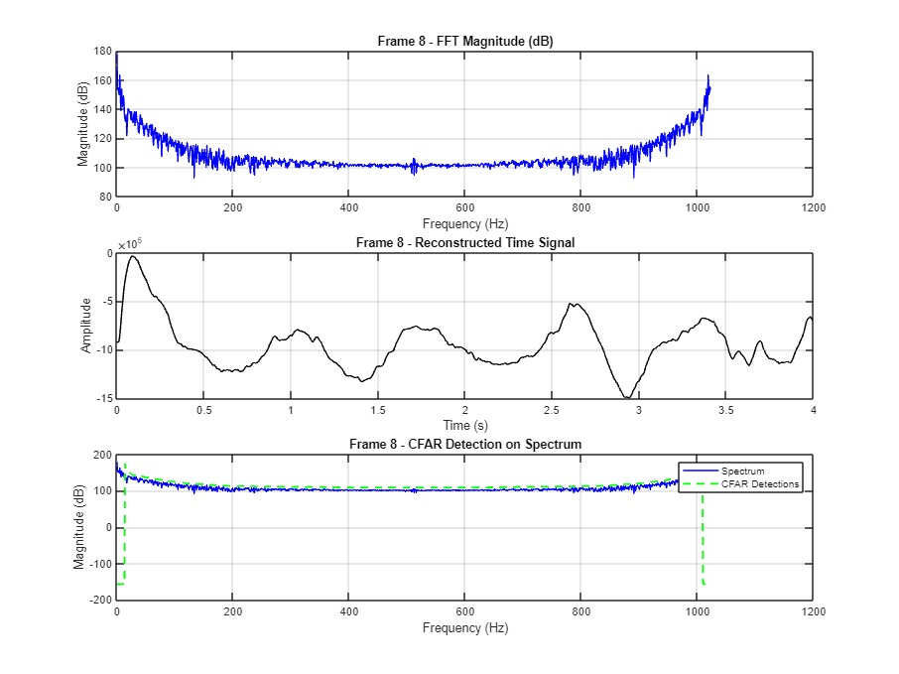
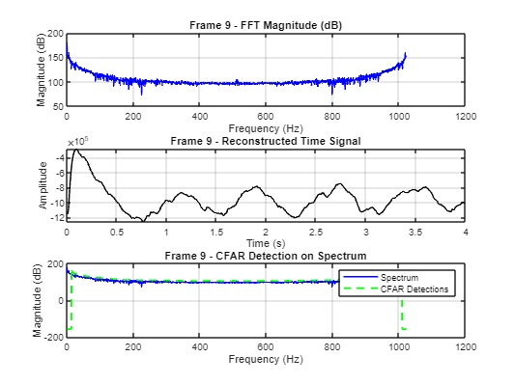
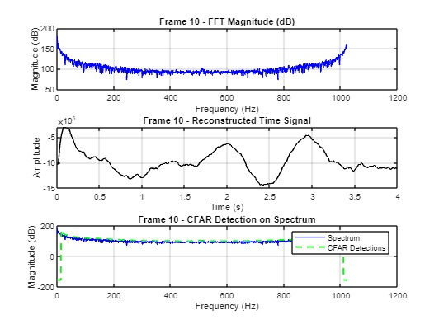

Slide 17


